Slide 1
GRAPH THEORY PROJECT 2023

Slide 2
Instructor: Dr. Nazish Kanwal Project Title: Bi-Graverse Project Contributors: Fizza Rashid 21K-3390 Sana Khalid 21K-3421

Slide 3
Content: 1. Introduction 2. Overview 3. Problem Statement 4. Methodology (Implementation and Testing) 5. Results 6. Conclusion

Slide 4
1. Introduction:
A bipartite graph is a type of graph whose vertices can be divided into two disjoint sets such that every edge connects a vertex in one set to a vertex in the other set.
The flexibility and applicability of bipartite graphs make them a valuable tool in various domains, allowing for the modelling and analysis of diverse problems.

Slide 5
2. Overview:
Maximum flow algorithms, such as the Ford-Fulkerson algorithm, can be applied to bipartite graphs to find the maximum flow between two specific vertices, typically representing a source and a sink.
A matching in a graph refers to a set of edges without common vertices. In a bipartite graph, matching problems often involve finding a set of edges that covers all vertices on one side without sharing vertices.
For example: modelling relationships, Marriage problem.

Slide 6
3. Problem Statement
Problem: Job Assignment
Consider a scenario where there are N job applicants and M job positions available. Each job applicant has a set of skills, and each job position requires a specific set of skills. We want to find the best possible matching of applicants to positions such that each job position is filled, and applicants are assigned to positions based on their skills.
Solution: Optimised Job Assignment
The Max. Bipartite Matching provides an optimal assignment of job applicants to positions, ensuring that each position is filled with a suitable candidate.

Slide 7
3. Problem Statement
Problem: Transportation Network
Consider a transportation network with multiple sources (e.g., factories) and sinks (e.g., distribution centres or cities). The goal is to optimize the flow of goods from sources to sinks, taking into account the capacities of the edges (roads, pipelines, etc.) connecting them.
Solution: Transportation Network Optimisation
The Max. Flow Methods provide an optimal distribution of goods from sources to sinks, ensuring that the transportation network operates at maximum efficiency.

Slide 8
3. Methodology
Bipartiteness Check
Enabling the feature to visualise Maximum Bipartite Matching.
Calculate Maximised Flow of any weighted graph using Edmond-Karp Algorithm(Python)
& Ford-Fulkerson Algorithm(Java)

Slide 9
Functionalities and their Implementation:
Language used: Python(via Jupyter Notebook)
Check if Graph is ‘Bipartite’ or not.
If ‘Yes’, Enables the feature to visualise maximum bipartite Matching efficiently.
Moreover, It provides visualization of
optimised Maximum flow of respected
Graph(Any Weighted Graph) using
matplotlib.

Slide 10
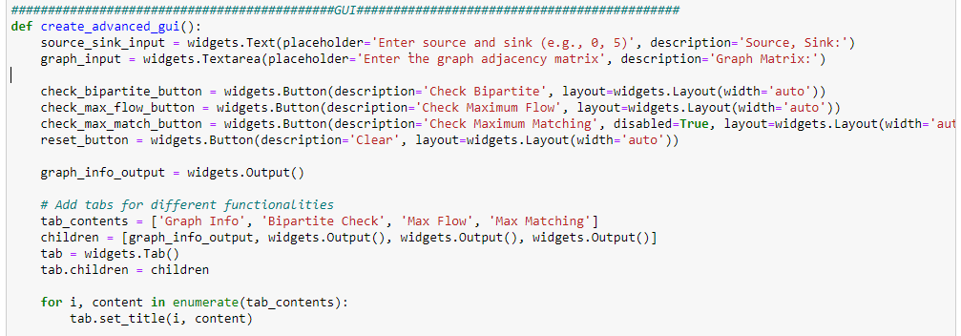
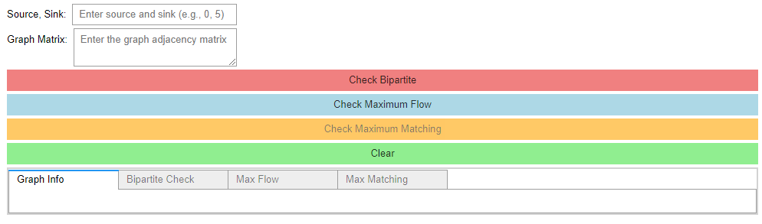
GUI Implementation Using Python widgets (lib: ipywidgets)

Slide 11
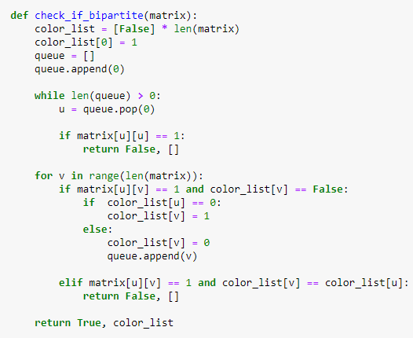
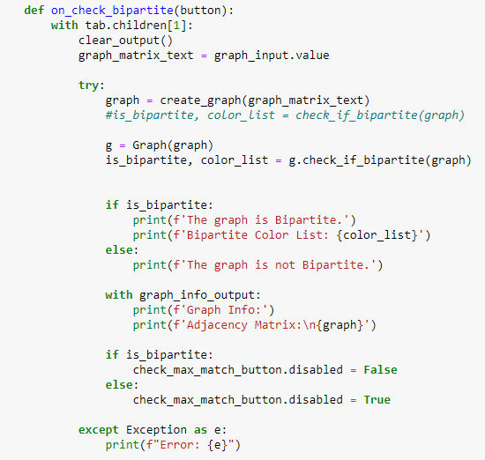
Check whether proposed graph is ‘bipartite’ or not:
-If ‘Yes’, enable rest of the features,
-Otherwise no more functionalities available.

Slide 12
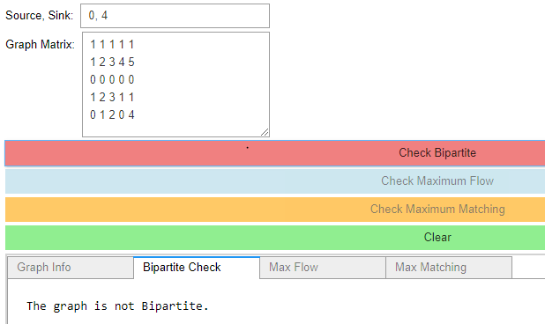
Checking random Graphs
1. (Output: Not Bipartite)

Slide 13
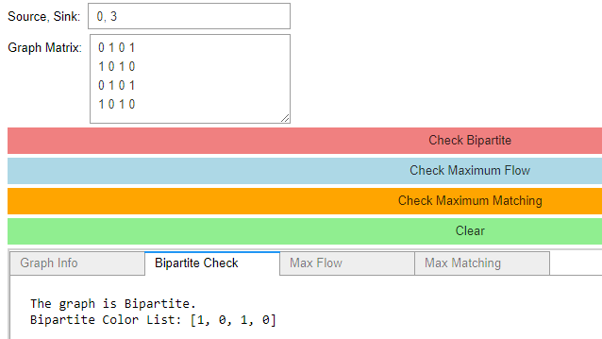
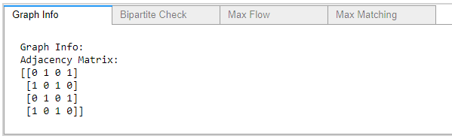
Checking random Graphs
2. (Output: Is Bipartite)

Slide 14
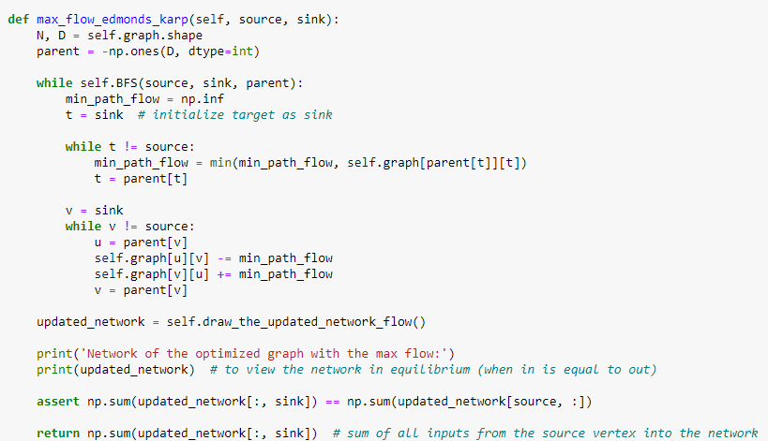
Optimised Maximum Flow Implementation

Slide 15
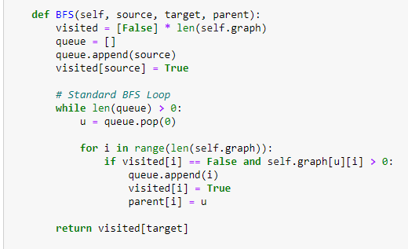
Optimised Maximum Flow Implementation

Slide 16
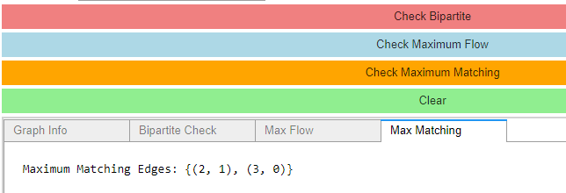
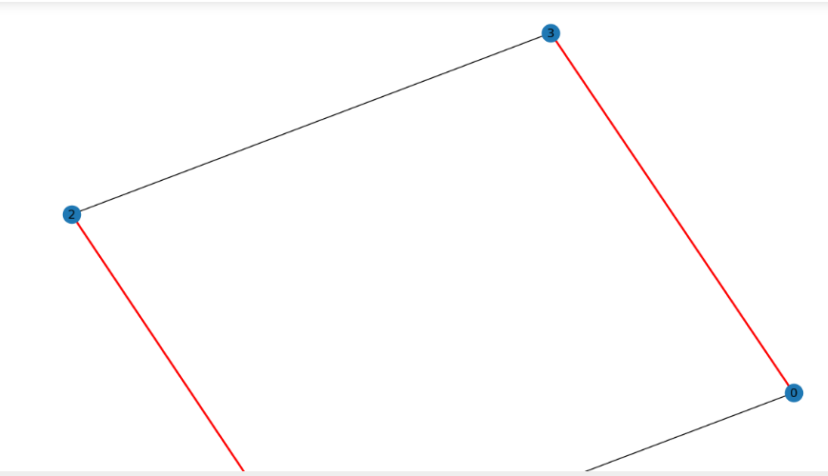
Checking random Graphs
2. (Output: Is Bipartite)
Visualising Maximum Matching of Given Bipartite Graph

Slide 17
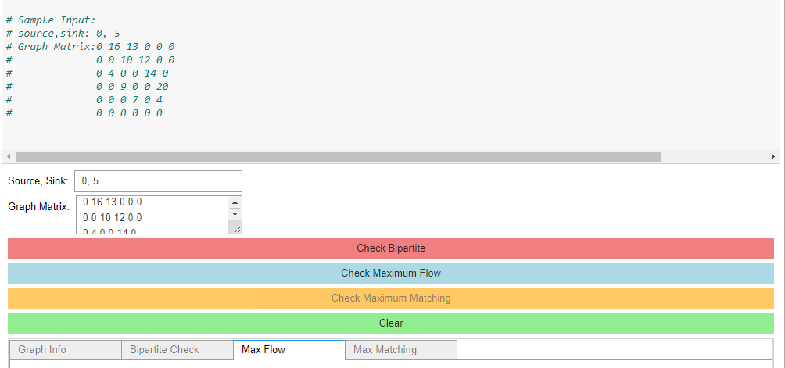
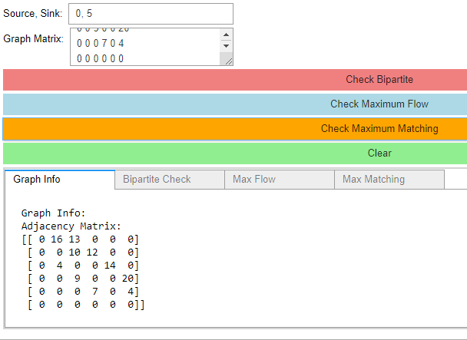
Checking random Graphs
Maximised Flow Of Graph Using Edmond-Karp Method

Slide 18
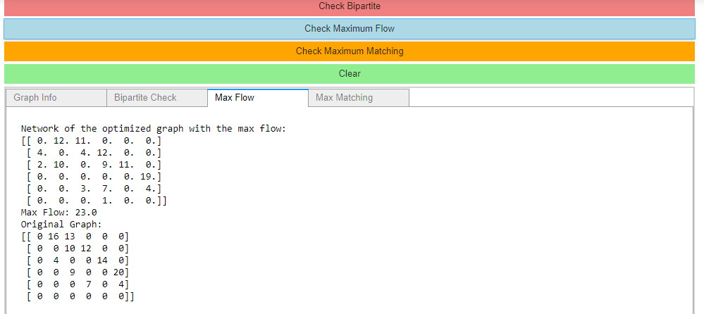
Checking random Graphs
Maximised Flow Of Graph Using Edmond-Karp Method

Slide 19
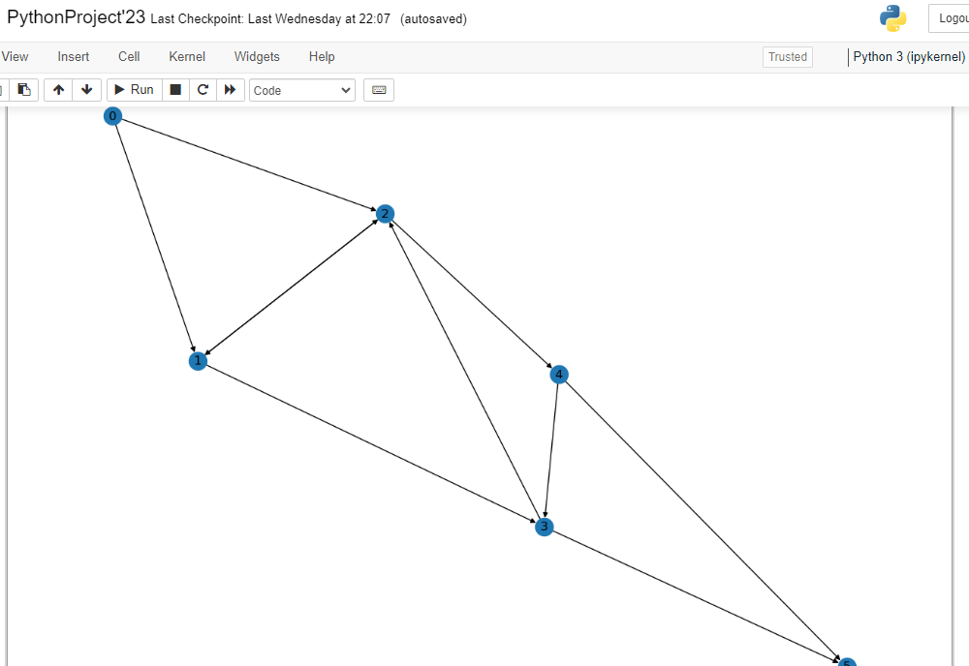
Checking random Graphs
Maximised Flow Of Graph Using Edmond-Karp Method
(Visualisation)

Slide 20
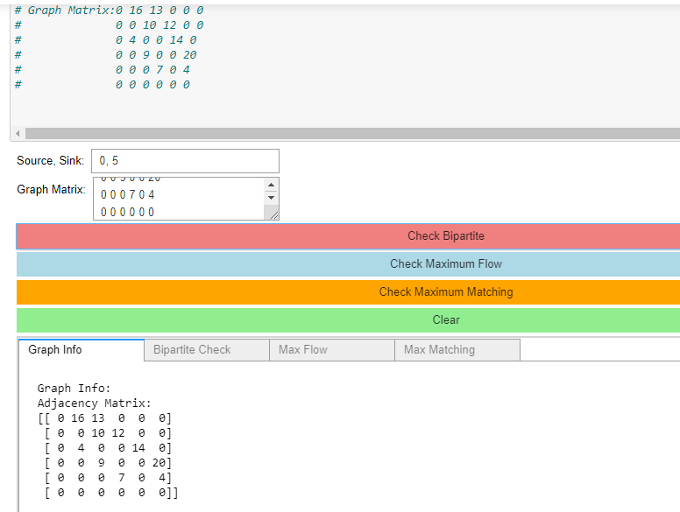
Checking random Graphs
Graph Info & Bipartiteness Check of above example graph

Slide 21
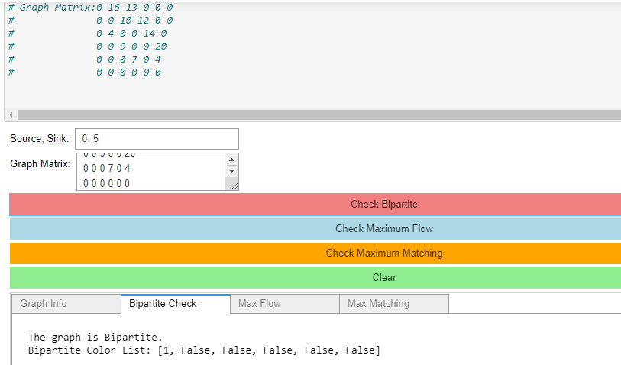
Checking random Graphs
Graph Info & Bipartiteness Check of above example graph

Slide 22
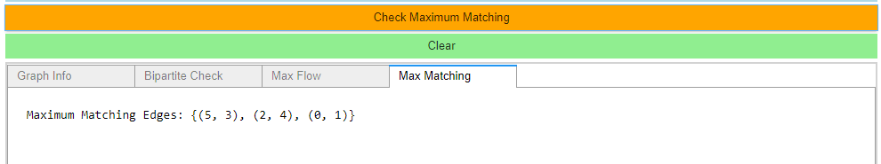
Checking random Graphs
Maximum Matching of above Input graph

Slide 23
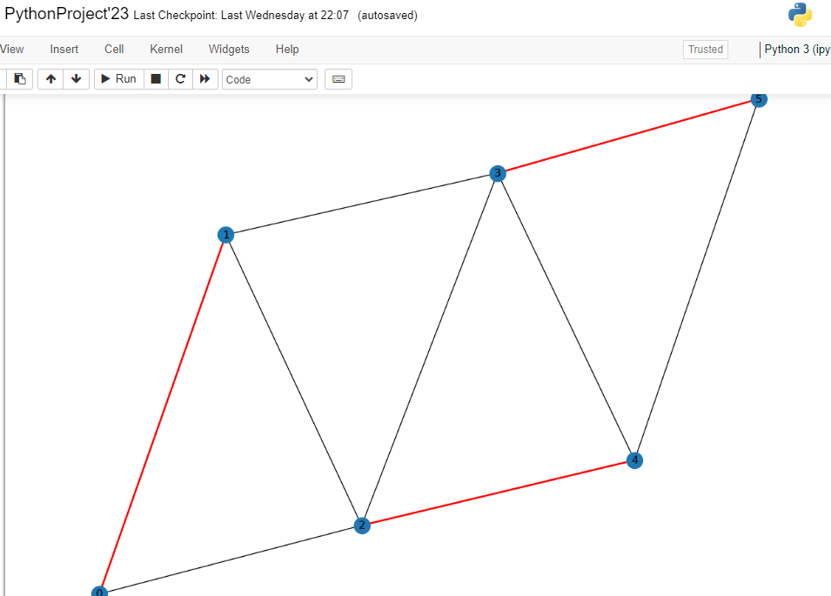
Checking random Graphs
Maximum Matching of above Input graph
(Visualisation)

Slide 24
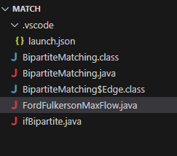
Functionalities and their Implementation:
Language used: Java(via VS code)

Slide 25
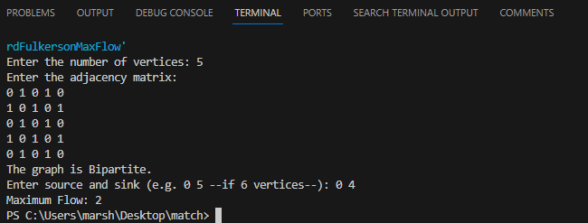
Bipartite Check:
(Output: Is Bipartite)

Slide 26
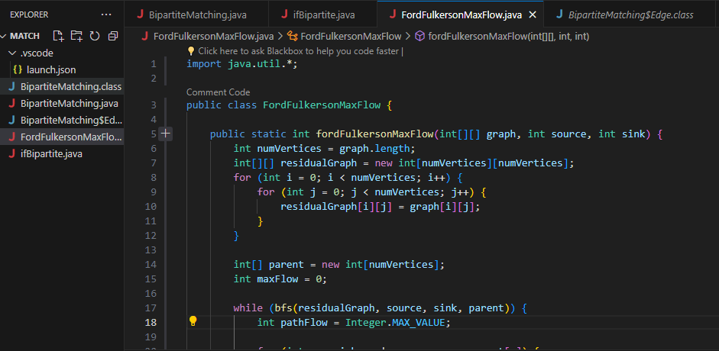
Ford-Fulkerson Max. Flow:
Language used: Java(via VS code)

Slide 27
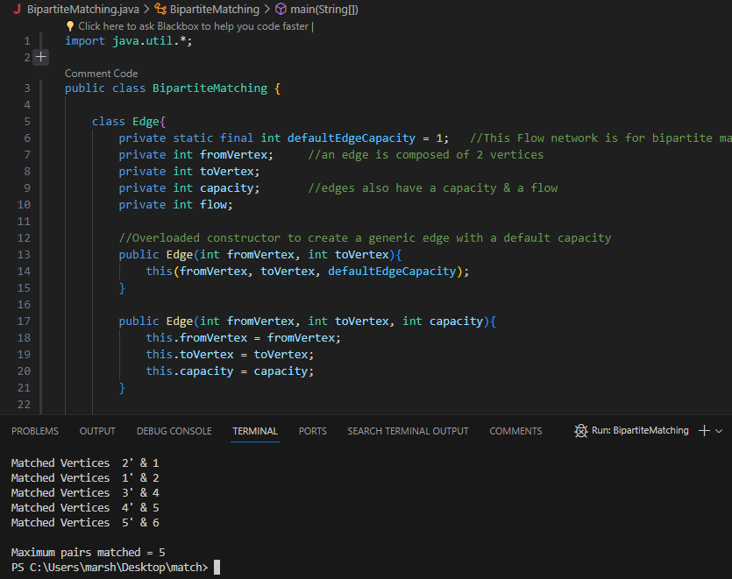
Bipartite Maximum Matching:

Slide 28
Ford-Fulkerson VS Edmond Karp Max Flow
Runtime Complexity:
Ford-Fulkerson: The runtime complexity is not guaranteed to be polynomial in the worst case because of its dependence on the choice of augmenting paths.
Edmonds-Karp: Guarantees a polynomial runtime of O(VE^2) due to its consistent choice of augmenting paths.
Guaranteed Termination:
Ford-Fulkerson: It may not terminate if improper augmenting paths are chosen, leading to the possibility of an infinite loop.
Edmonds-Karp: It always terminates because it chooses augmenting paths based on the shortest path criterion, ensuring convergence.

Slide 29
Important Note:
Ford-Fulkerson is a general method for computing the maximum flow in a flow network, while the Edmonds-Karp algorithm is a specific implementation of the Ford-Fulkerson method that uses Breadth-First Search (BFS) to find augmenting paths.

Slide 30
5. Results:
The algorithm outputs the maximum flow value and the flow configuration on each edge in the network.
The Edmonds-Karp algorithm guarantees an efficient solution to the maximum flow problem, and its time complexity is O(VE^2), where V is the number of nodes and E is the number of edges in the graph.
6. Conclusion:
The Edmonds-Karp algorithm provides a mathematical approach to solving complex optimization problems, helping to make informed decisions in real-life applications where the efficient flow of resources or information is crucial.

Slide 31
The End.

